Slide 1
203 Section: Week 4
Circulation & California Precipitation

Slide 2
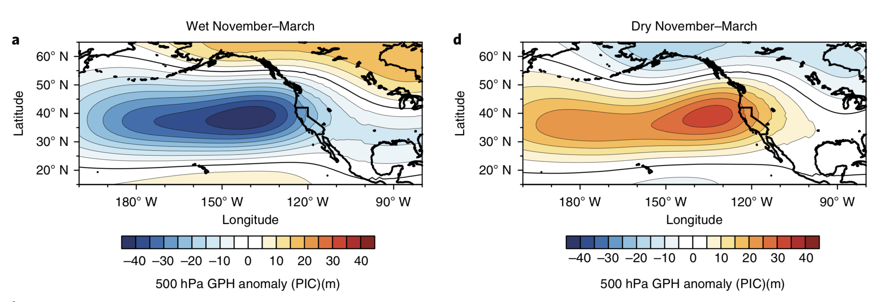
Review: Geopotential heights
Swain et al. 2018
Notes:
Composite maps depicting anomalies in November–March 500 hPa GPH during wet (80th percentile, left column) and dry (20th percentile, right column) March–November seasons in the CESM-LENS simulation.
Triple R: https://weatherwest.com/archives/5982

Slide 3
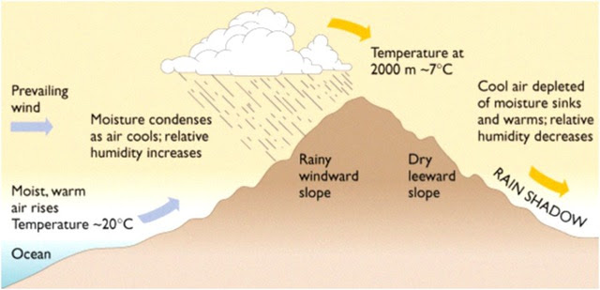
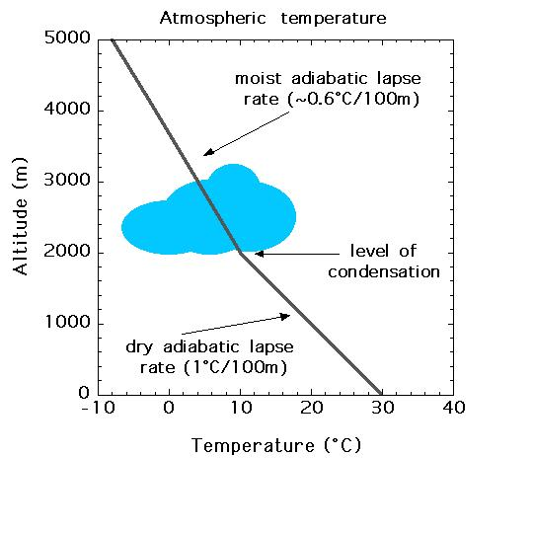
Review: adiabatic lapse rates and orographic lift

Slide 4
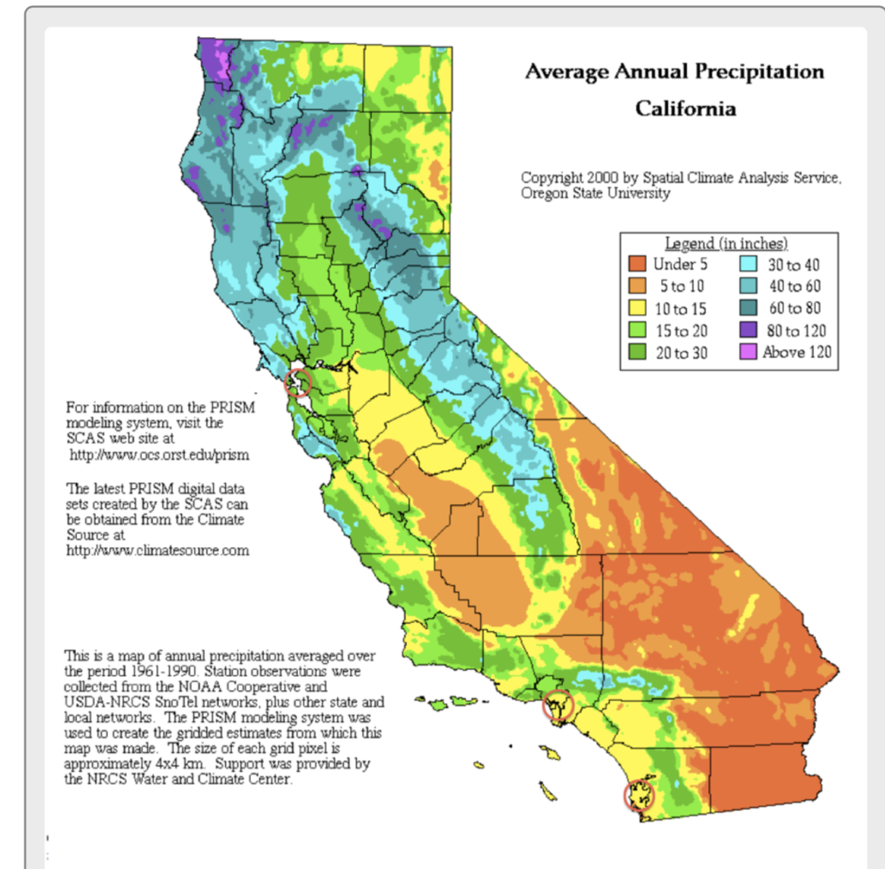
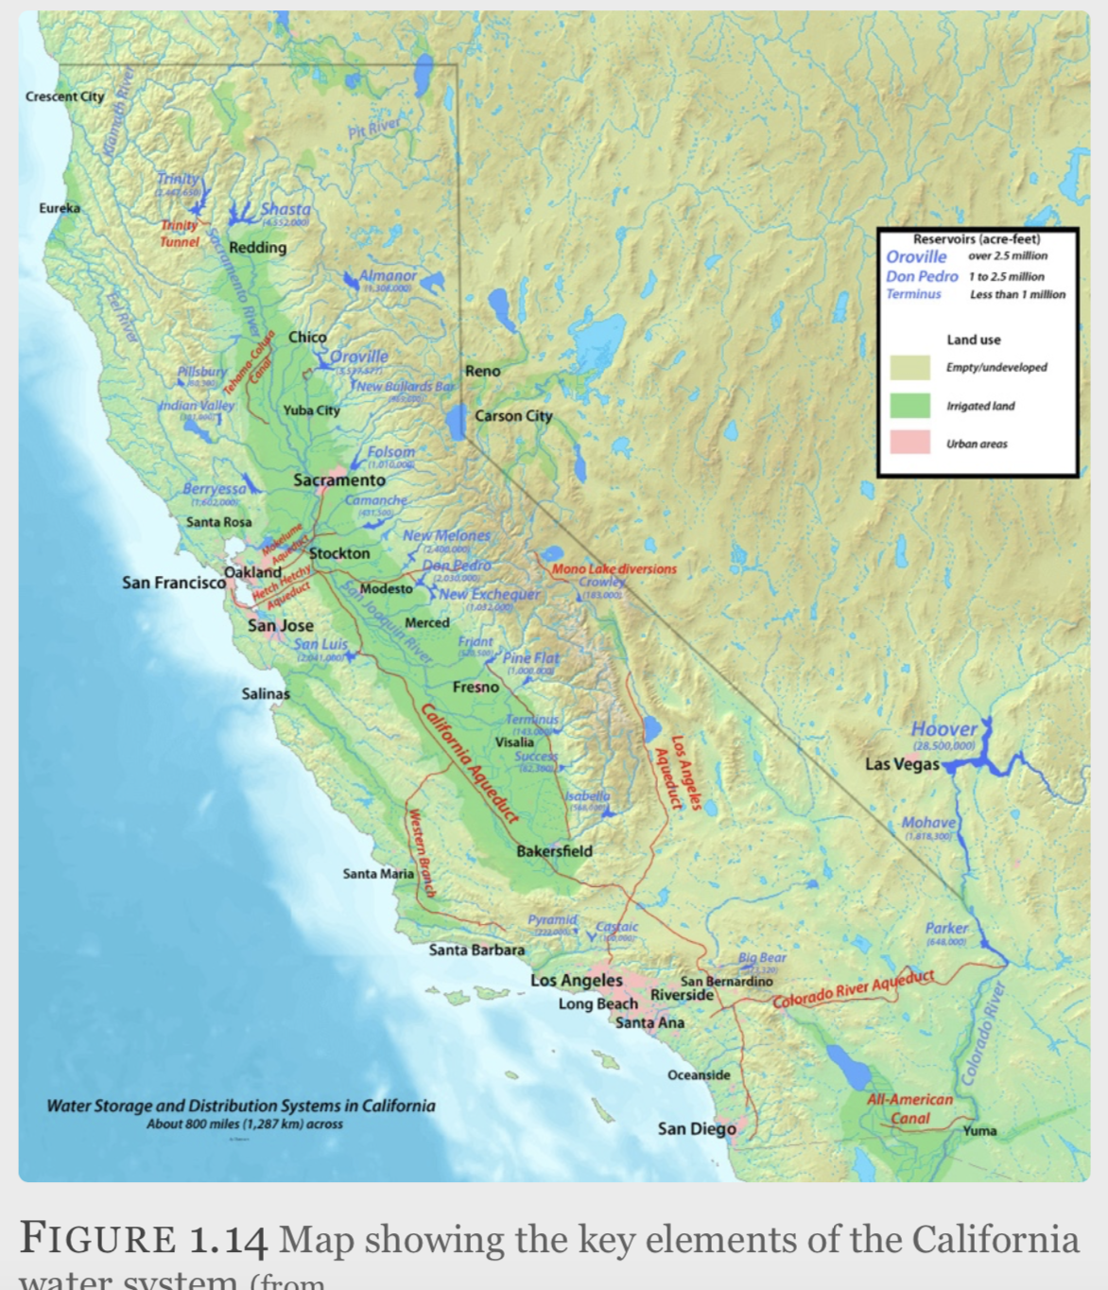

Slide 5
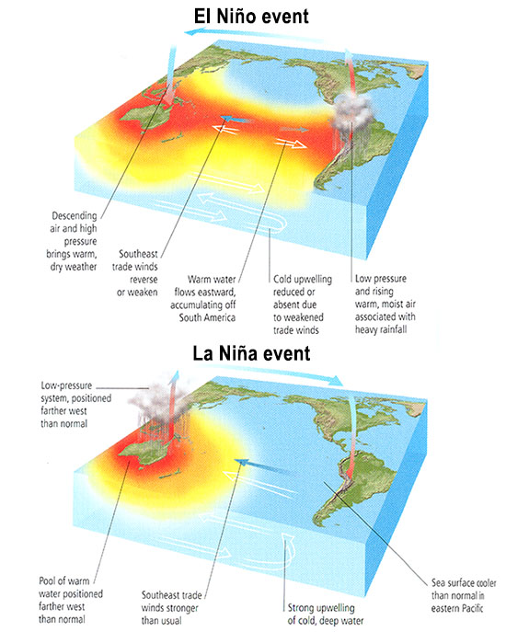
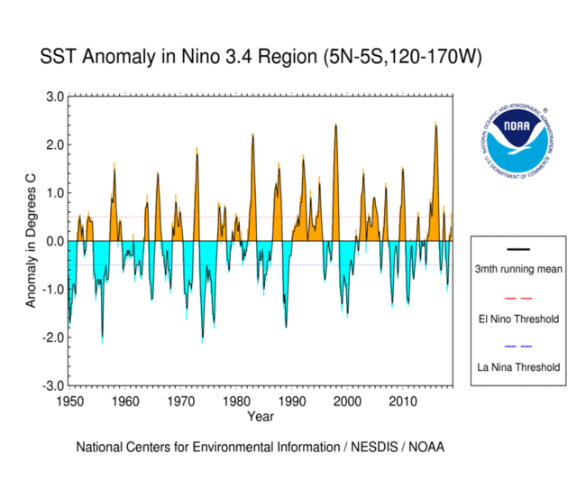
Review: El Niño

Slide 6
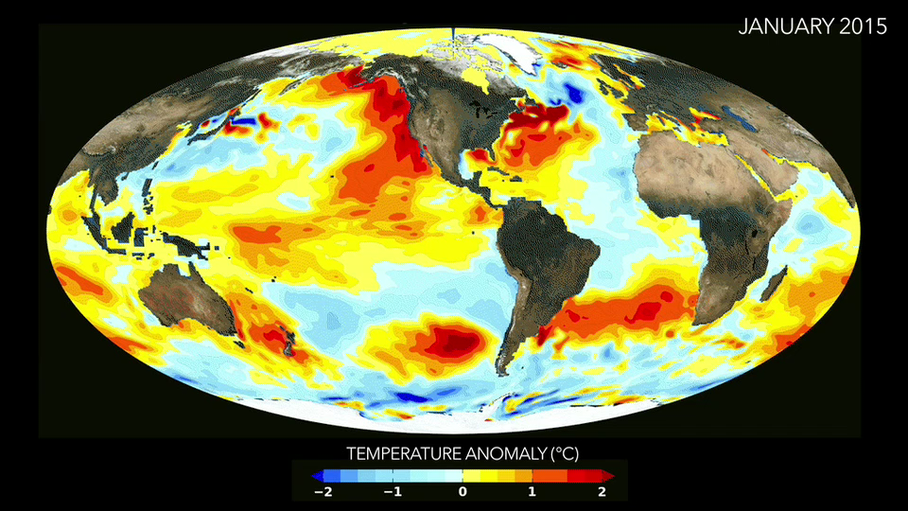
ENSO
Other helpful links:
US Precip Anomolies for every El Niño since 1950
Climate.gov

Slide 7
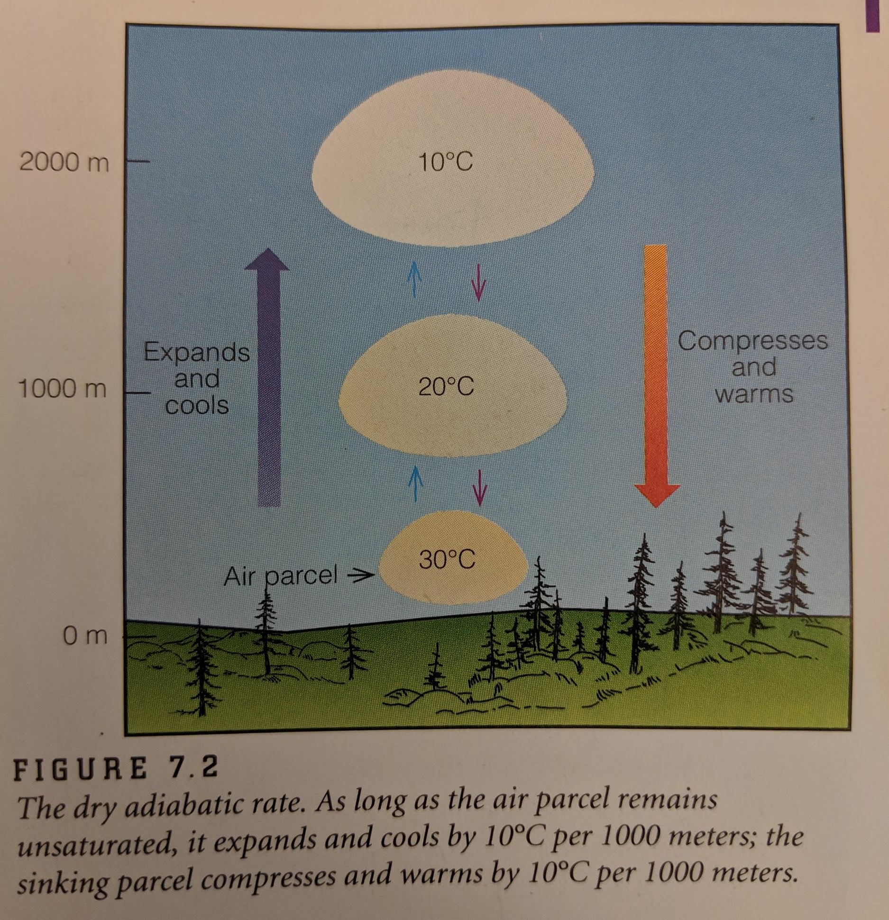
Extra ALR

